Slide 1
Toronto Cycling Infrastructure Questions
Richard Wen
Postdoctoral Fellow
Dalla Lana School of Public Health
University of Toronto
richard.wen@utoronto.ca
July 9, 2024

Slide 2

Research Objectives
For dedicated cycling infrastructure (painted lanes, buffered lanes, and cycle tracks as defined by the Canadian Bikeway Comfort and Safety (Can-BICS)⁹ classification system) in the city of Toronto from 2010 to 2022:
(1) Verify that city installation and upgrade data are accurate
(2) Evaluate yearly trends in cycling infrastructur

Slide 3

Data: Toronto Cycling Network
Toronto Bikeways
open.toronto.ca/dataset/cycling-network
(Downloaded January 2023)
1323 Road Segments
Types: Cycle tracks, bike lanes, neighborhood routes with sharrows, multi-use trails, signed cycling routes
Included: Cycle tracks, bike lanes

Slide 4



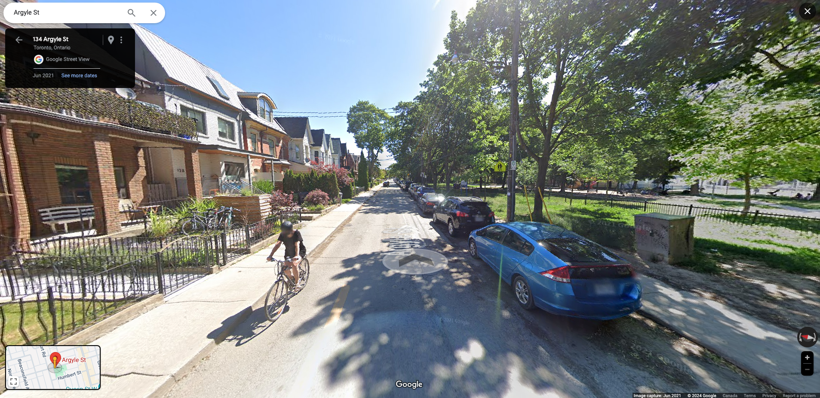
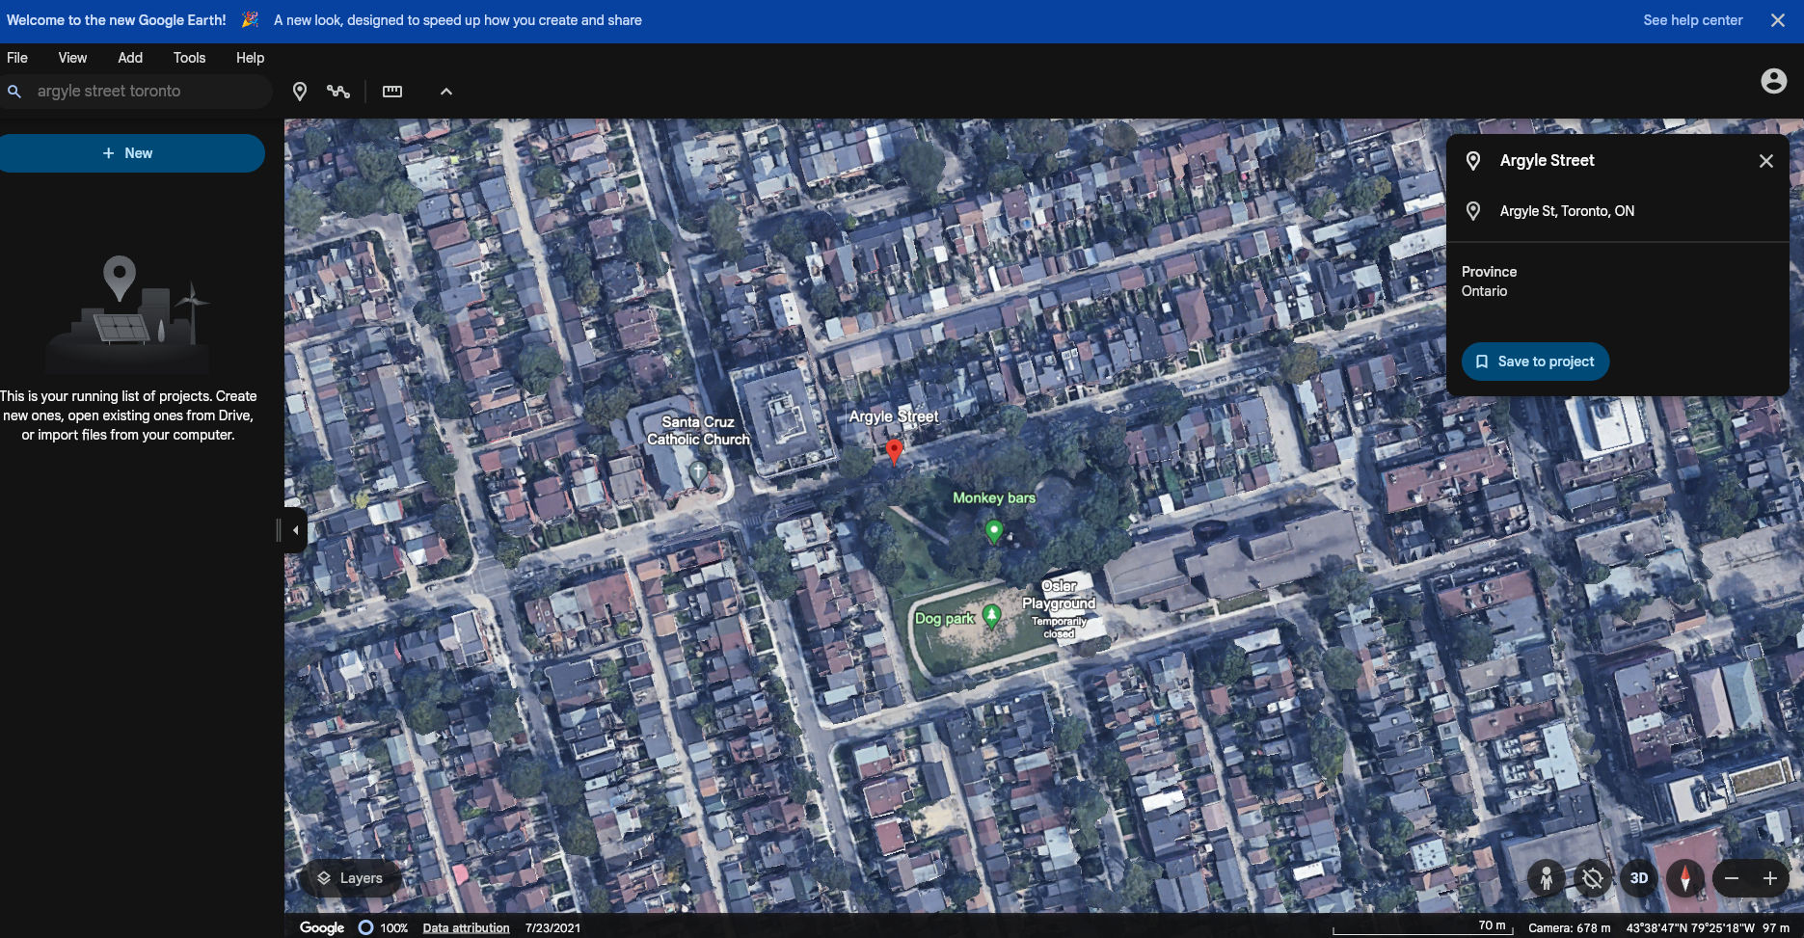

Methods: Verification of Installations and Upgrades

Slide 5



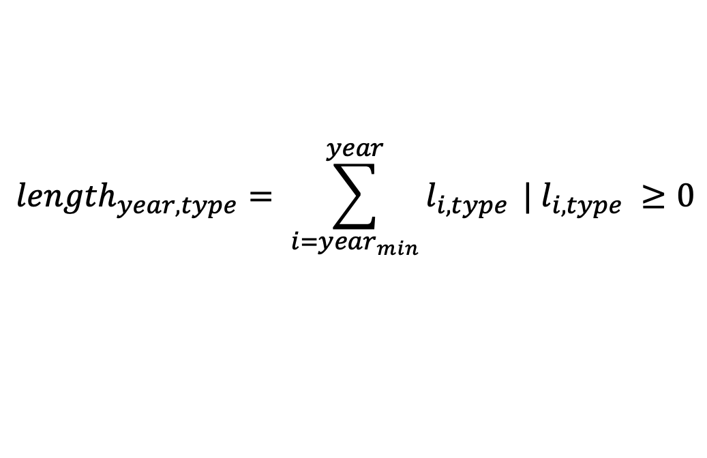
Methods: Evaluation
Yearly Road Lengths
$${length}_{year, type}= \sum_{i={year}_{min}}^{year}{l_{i,type}} | l_{i,type} ≥0$$
Adjusted Yearly Road Lengths
$${length}_{year,type}^{install}+ {length}_{year,type}^{change}− {length}_{year,type}^{replacement}$$

Slide 6
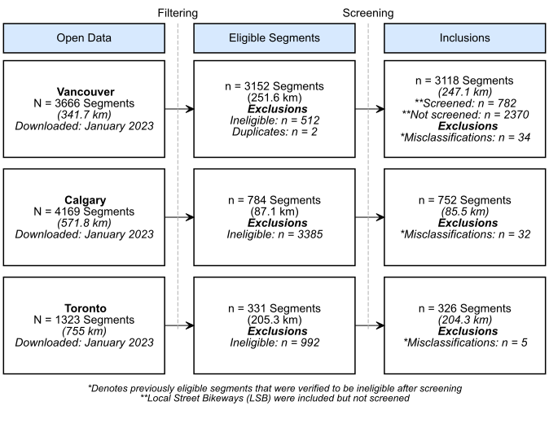
Results: Segment Inclusions and Exclusions

Slide 7
Results: Installation Year Accuracy
74.5% Correct
78.2% ±1 Year
0 = Correct

Slide 8
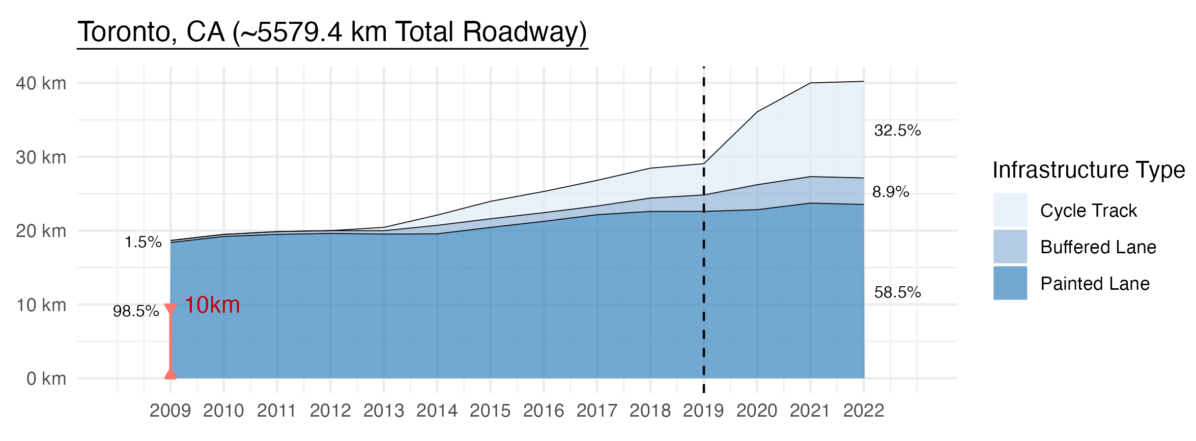
Results: Infrastructure per 1000 km of Roadway

Slide 9
Results: Net Change per 1000 km of Roadway

Slide 10
Results: Changes Since January 2020

Slide 11
Questions
Why the difference in installation years (74.5% Correct, 78.2% ±1 Year)?
Is the increase in cycling infrastructure?
2009-2022: 1.5% cycle track to 32.5% cycle track
COVID-19 period (after 2019): >6X net change in cycling infrastructure

